Slide 1


APK 6725 AI for Sports and Movement Sciences
Introduction to Machine Learning

Slide 2
Introduction to Machine Learning
In its core, machine learning techniques allow us to build mathematical models to help us understand data.
These models have tunable (often called weights and biases) which are iteratively adjusted to minimize a loss function during the training process using data. This process allows us to learn from the data.
Once these models have been fit to previously seen data, they can be used to predict and understand aspects of newly observed data.

Slide 3
Introduction to Machine Learning
Machine learning can be categorized in different ways. At the most fundamental level, it can be classified based of the type of data under analysis
- Supervised Learning involves modeling the relationship between measured features of data and some label associated with the data. Supervised Learning is further subdivided into classification tasks and regression tasks: in classification, the labels are discrete categories, while in regression, the labels are continuous quantities.
- Unsupervised Learning involves modeling the features of a dataset without reference to any label. Unsupervised Learning is further subdivided into tasks such as clustering and dimensionality reduction.

Slide 4
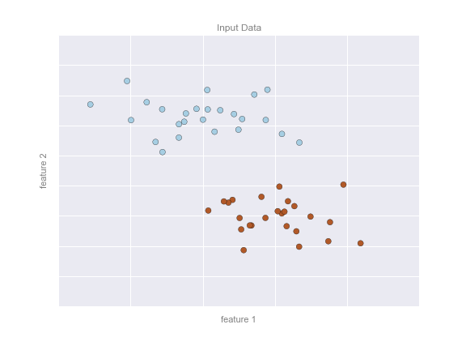
Introduction to Machine Learning
Classification – Predicting discrete labels
In a classification problem, there are typically multiple features (or measures) and each feature set is associated with a label (or class).
In this example, we have two features for each data point, and a label, represented by the color of each point.

Slide 5
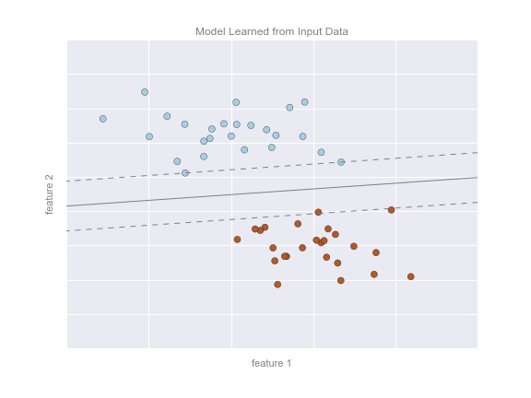
Introduction to Machine Learning
Classification – Predicting discrete labels
The objective of the classification problem is to define a boundary in the feature space that can separate the classes. This boundary can be a line or a more complex shape.
Classification problems usually have more than two features, so the separation in the feature space might not be intuitive.

Slide 6
Introduction to Machine Learning
Classification – Predicting discrete labels
Once the boundary is defined, we can use it to classify new data that does not have a label.
What is the label of the black dot ?
What is the label of the green dot ?

Slide 7
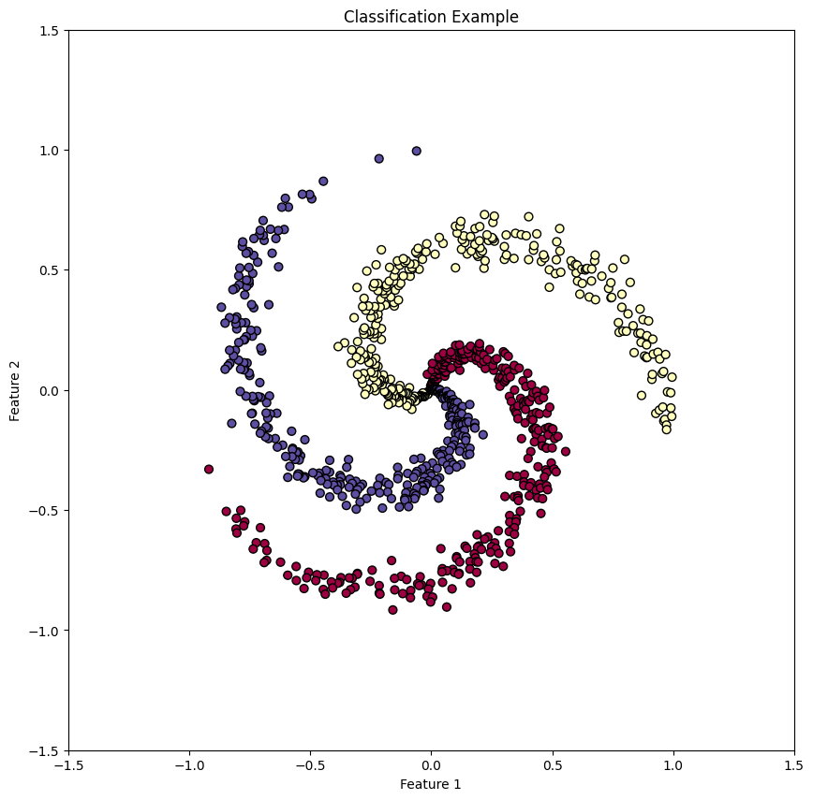
Introduction to Machine Learning
Classification – Predicting discrete labels
Not all classification problems are linearly separable, we will learn methods that can learn non-linear boundaries to separate the data.

Slide 8
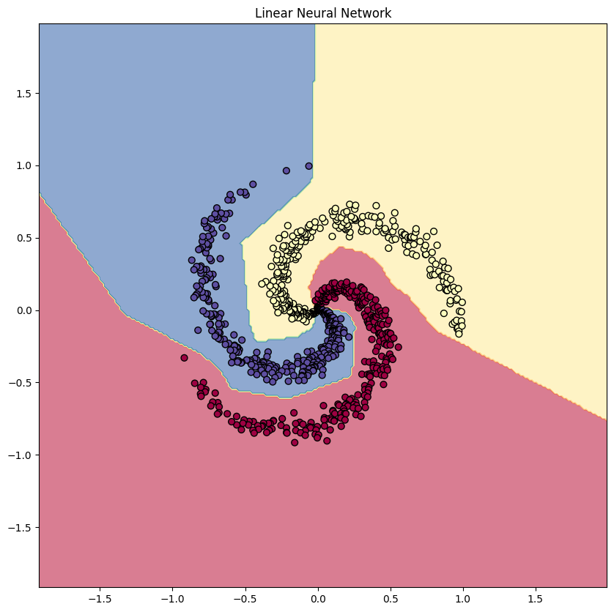
Introduction to Machine Learning
Classification – Predicting discrete labels
Not all classification problems are linearly separable, we will learn methods that can learn non-linear boundaries to separate the data.

Slide 9
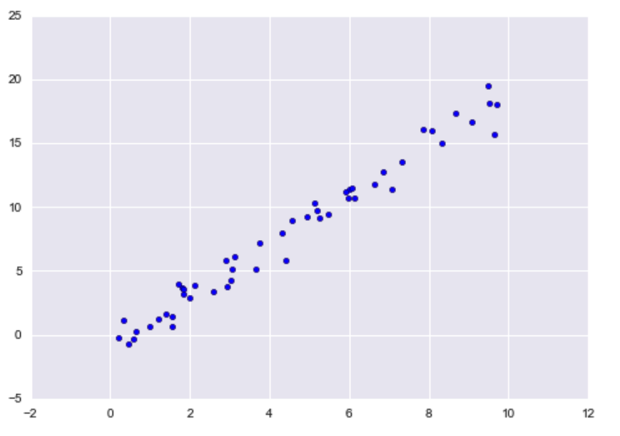
Introduction to Machine Learning
Regression – Predicting continuous labels
In a regression problem, there are typically one or multiple features (called independent variable(s)) and each feature set is associated with an output (or dependent variable).
In this example, we have one independent variable (plotted in the x-axis) and one dependent variable (plotted in the x-axis)
Dependent variable (y)
Independent variable (x)

Slide 10
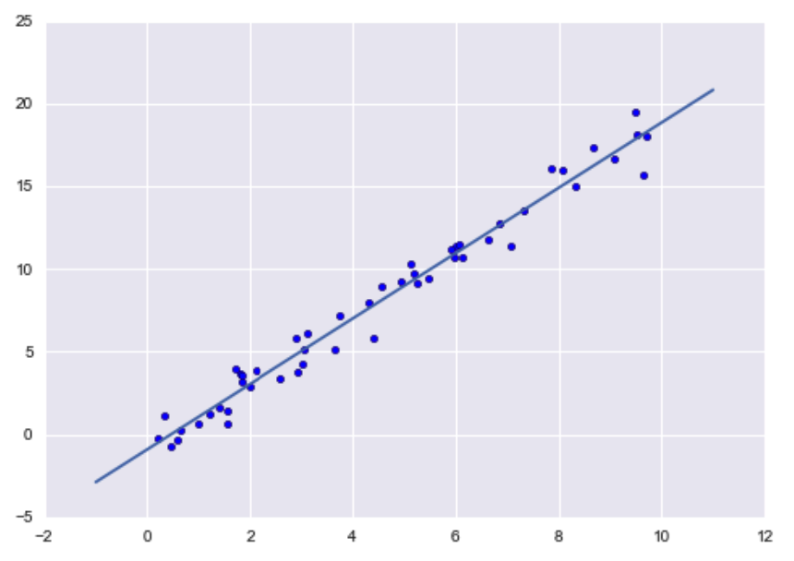
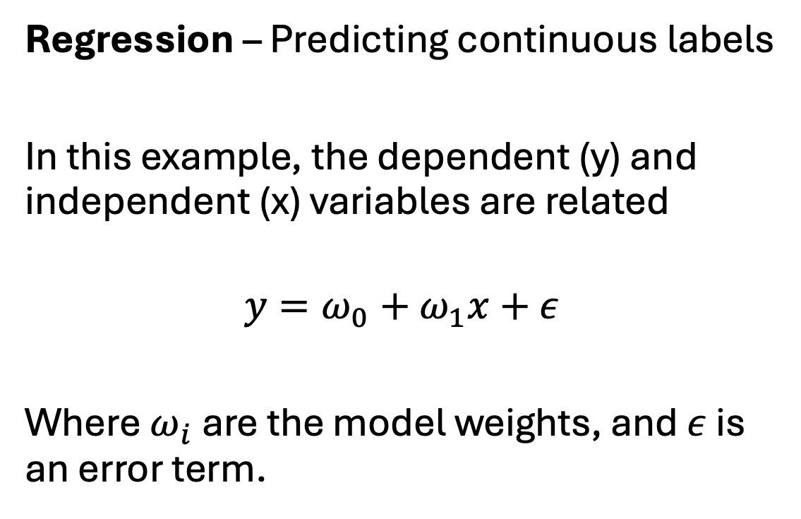
Introduction to Machine Learning
Regression – Predicting continuous labels
In this example, the dependent (y) and independent (x) variables are related
$$y=ω_{0}+ω_{1}x+ε$$
Where${ ω}_{i}$ are the model weights, and $ε$ is an error term.
Dependent variable (y)
Independent variable (x)

Slide 11
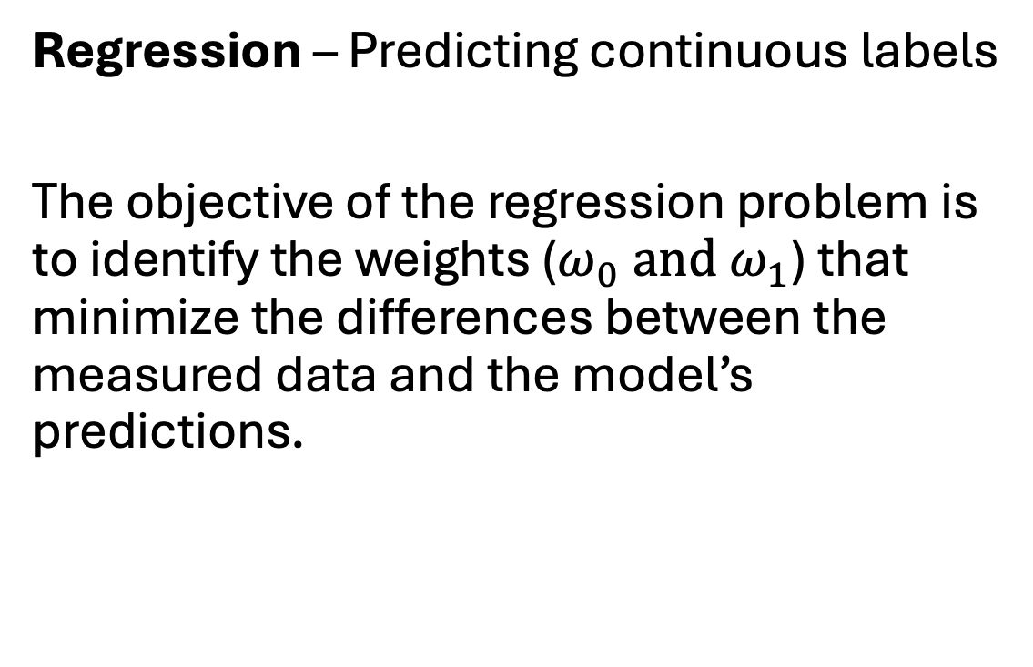
Introduction to Machine Learning
Regression – Predicting continuous labels
The objective of the regression problem is to identify the weights ($ω_{0} and ω_{1}$) that minimize the differences between the measured data and the model’s predictions.
Dependent variable (y)
Independent variable (x)

Slide 12
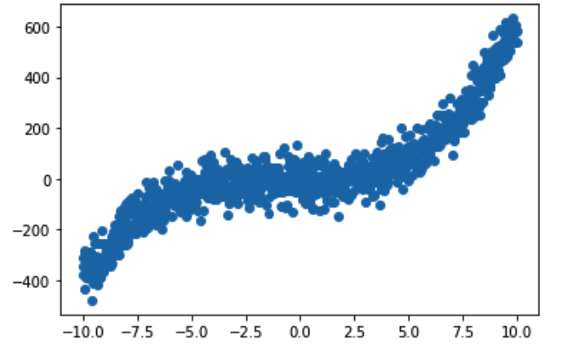
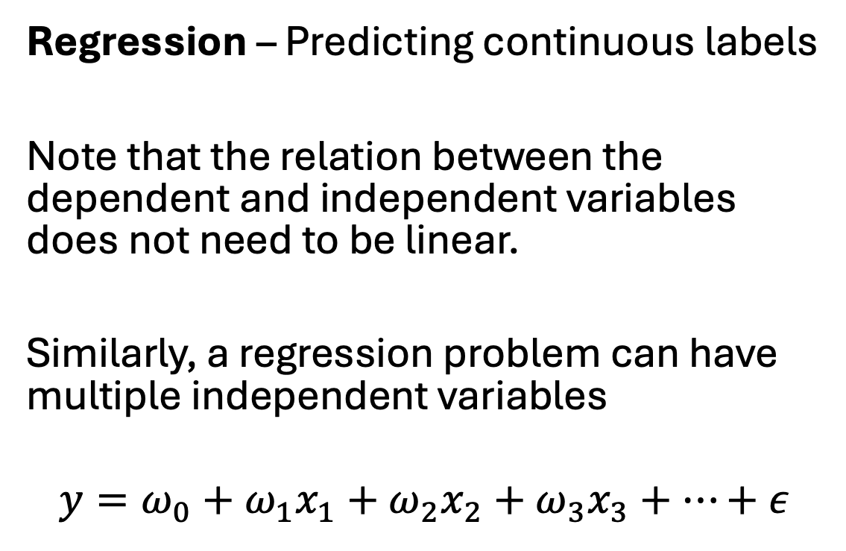
Introduction to Machine Learning
Regression – Predicting continuous labels
Note that the relation between the dependent and independent variables does not need to be linear.
Similarly, a regression problem can have multiple independent variables
$$y=ω_{0}+ω_{1}x_{1}+ω_{2}x_{2}+ω_{3}x_{3}+…+ε$$
Dependent variable (y)
Independent variable (x)

Slide 13
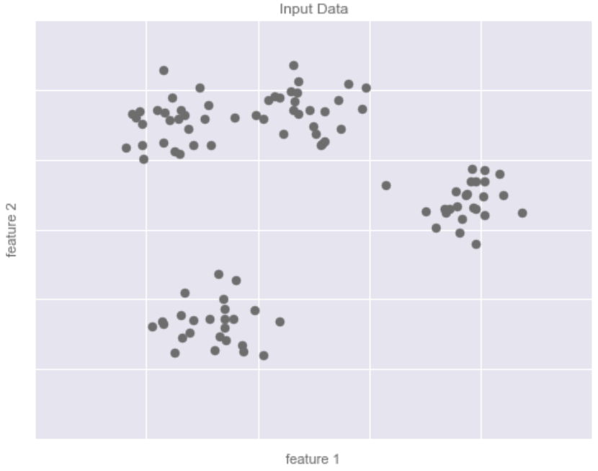
Introduction to Machine Learning
Clustering – Inferring labels from data
Clustering is a common unsupervised learning problem. In a clustering problem, the features can typically be separated into different groups.
A clustering algorithm will use the structure of the data to determine how many groups are present and the class for each measurement.

Slide 14
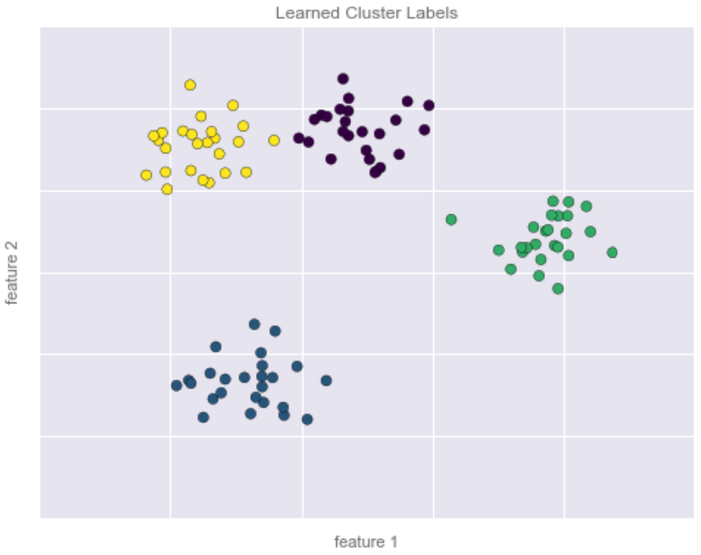
Introduction to Machine Learning
Clustering – Inferring labels from data
In this example, the data can be separated into four groups.
Once the groups are identified, is possible to assign new data to a cluster.
What is the cluster of the black dot ?
What is the cluster of the orange dot ?

